Slide 1
What is the internet?
What is the internet?
https://youtu.be/Dxcc6ycZ73M
Internet Infrastructure as Fast As Possible
https://youtu.be/n71TUnTNdw8
How the Internet Works for Developers
https://youtu.be/e4S8zfLdLgQ

Slide 2
Chapter 1
Introduction to web development

Slide 3
Objectives
Applied
Load a web page from the Internet or an intranet into a web browser.
View the source code for a web page in a web browser.
Knowledge
Describe the components of a web application.
Distinguish between the Internet and an intranet.
Describe HTTP requests and responses.
Distinguish between the way a web server processes static web pages and dynamic web pages.
Name the five major web browsers.
Describe the use of JavaScript.
Distinguish between HTML and CSS.

Slide 4
Objectives (cont.)
Explain how you deploy a website on the Internet.
Describe the components of an HTTP URL.
Describe these five web development issues: Usability, Cross-browser Compatibility, User Accessibility, Search Engine Optimization, and Responsive Web Design.

Slide 5
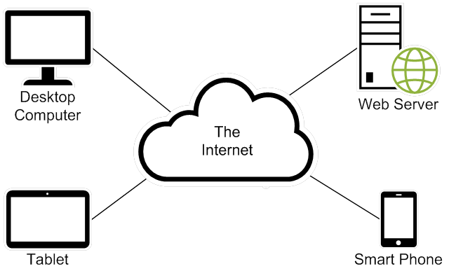
The components of a web application

Slide 6
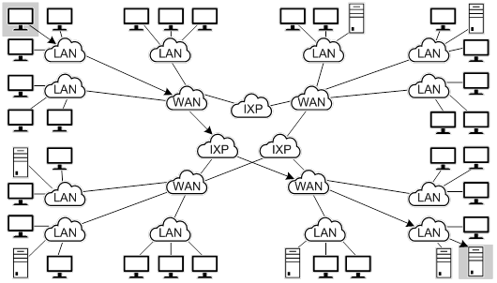
The architecture of the Internet

Slide 7
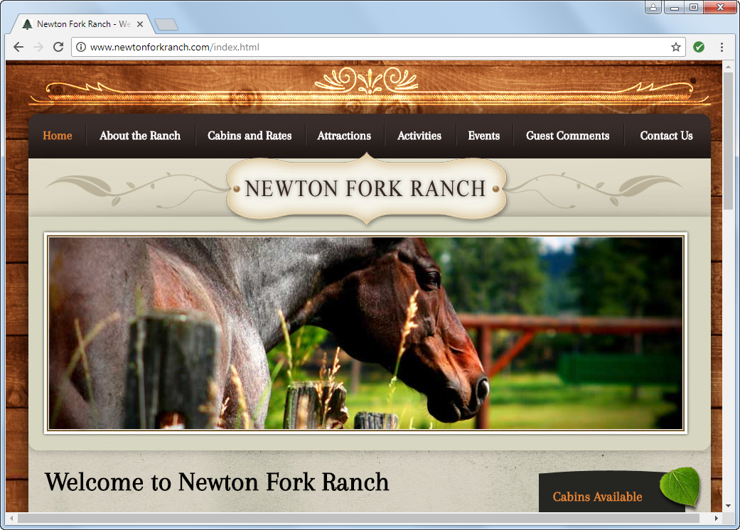
A static web page

Slide 8
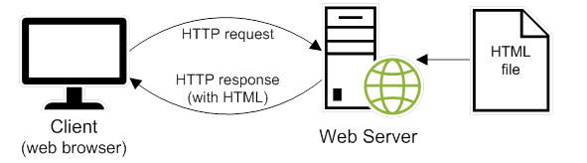
How a web server processes a static web page

Slide 9
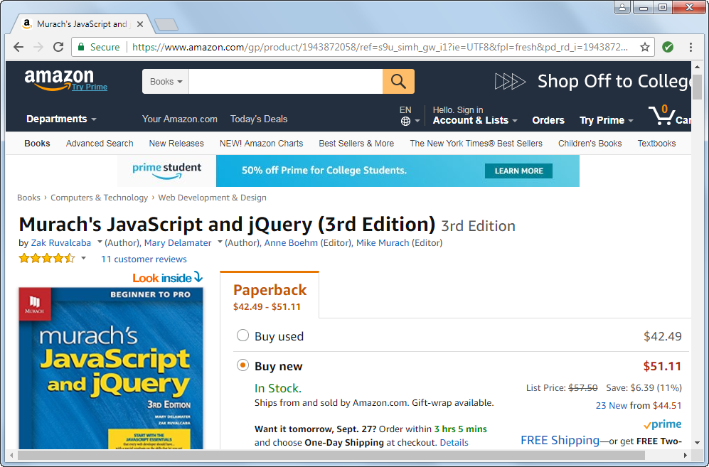
A dynamic web page at amazon.com

Slide 10
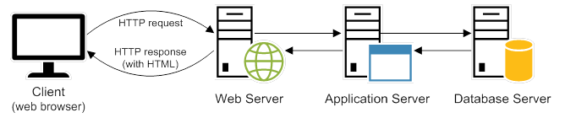
How a web server processes a dynamic web page

Slide 11
Web browsers
Chrome
Firefox
Edge
Internet Explorer
Safari
Opera

Slide 12
Server-side scripting languages
C#
Java
PHP
Ruby
Perl
Python

Slide 13
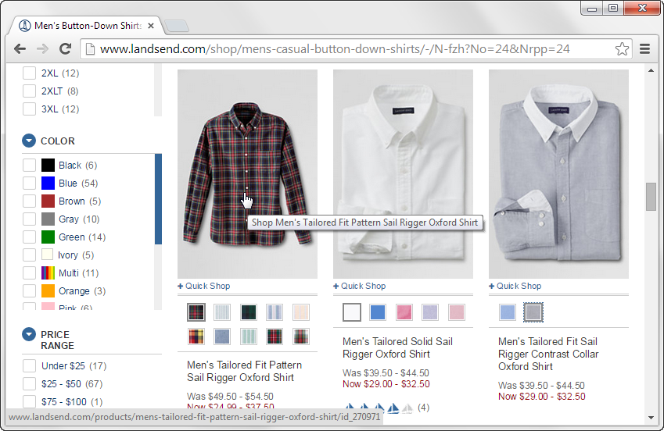
A web page with image swaps and rollovers

Slide 14
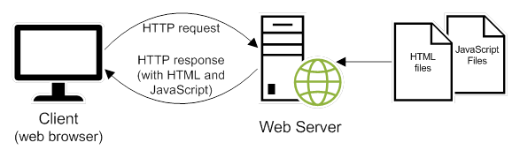
How JavaScript fits into this architecture

Slide 15
Three of the common uses of JavaScript
Data validation
Image swaps and rollovers
Accordions

Slide 16
The code for an HTML file
<!DOCTYPE html>
<html lang="en">
<head>
<meta charset="utf-8">
<title>JavaScript and jQuery book</title>
</head>
<body>
<h1>JavaScript and jQuery (3rd Edition)</h1>
<img src="javascript_jquery.jpg" alt="JavaScript and jQuery Book">
<p>Today, ... does best.</p>
<p>Now, ... <a href="">read more...</a></p>
</body>
</html>

Slide 17
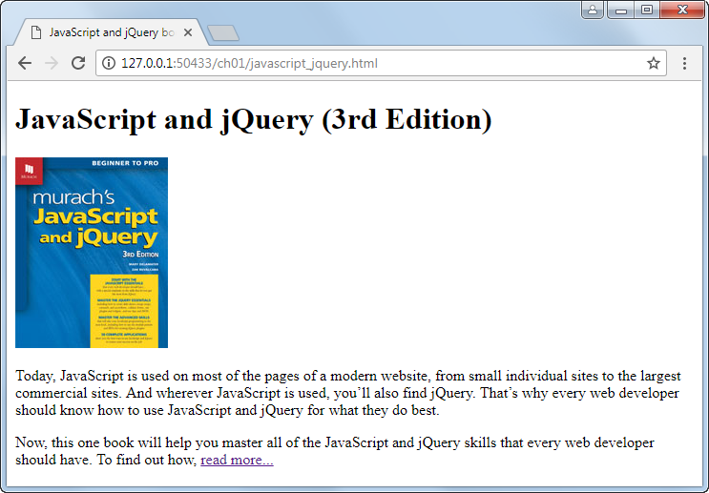
The HTML displayed in a web browser

Slide 18
Using CSS to change how the page looks
HTML is used to create the structure of a web page.
Cascading Style Sheets (CSS) is used to change the look of a web page.

Slide 19
The link element for a CSS file
<link rel="stylesheet" href="book.css">

Slide 20
The code for the CSS file named book.css
body {
font-family: Arial, Helvetica, sans-serif;
font-size: 100%;
width: 550px;
margin: 0 auto;
padding: 1em;
border: 1px solid navy;
}
h1 {
margin: 0;
padding: .25em;
font-size: 200%;
color: navy;
}
img {
float: left;
margin: 0 1em 1 em 1em; }
p {
margin: 0;
padding-bottom: .5em; }

Slide 21
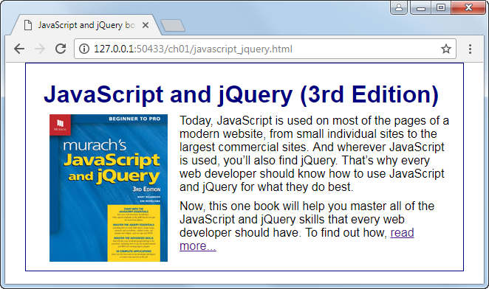
The web page displayed in a web browser

Slide 22
Websites to become familiar with
W3 Schools
https://www.w3schools.com/html/
Mozilla Developer Network
https://developer.mozilla.org/en-US/docs/Web/HTML/Reference

Slide 23
Free text editors
Visual Studio Code
Brackets
Atom
Notepad++
Sublime Text

Slide 24
Popular IDEs for web development
Visual Studio Code
Brackets
Atom
Microsoft Visual Studio
IntelliJ IDEA
WebStorm
NetBeans
Adobe Dreamweaver

Slide 25
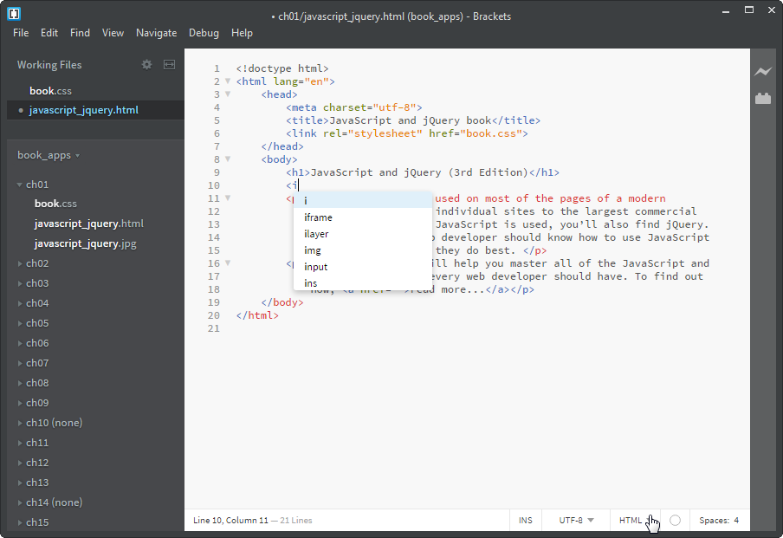
Brackets and its auto-completion feature

Slide 26
Some popular FTP programs
FileZilla
FTP Voyager
CuteFTP
Fetch
Most IDEs have FTP clients built in, or available as extensions.

Slide 27

The components of an HTTP URL
path
What happens if you omit parts of a URL
If you omit the protocol, the default of http:// will be used.
If you omit the filename, the default document name for the web server will be used.

Slide 28
Two ways to access a web page on the Internet
Enter the URL of a web page into the browser’s address bar.
Click on a link in the current web page to load the next web page.

Slide 29
Three ways to access a web page on your own server or computer
Use the features of your text editor or IDE.
Find the file in File Explorer or Finder. Then, double-click on it to open it in your default browser. Or, right-click on it and use the Open With command to select the browser.
If your browser has a menu bar, use the File→Open or File→Open File command.

Slide 30
Naming recommendations for folders and files
Create names for folders and files that consist of lowercase letters, numbers, underscores or hyphens, and the period.
Do not use uppercase letters in filenames, to avoid issues with case sensitive file systems.
Use filenames that clearly indicate what a page contains. This is good for search engine optimization.

Slide 31
How to view the source code for a web page
In Chrome, right-click the page and select the View Page Source command.
In Internet Explorer or Edge, right-click the page and select the View Source command.
In Chrome or Internet Explorer, the source code is displayed in a new browser tab or a separate window.
In Edge, the source code is displayed in the Debugger tab of the Developer Tools.

Slide 32
How to view the CSS code in an external CSS file
In Chrome, click on the link that refers to the CSS file.
In Edge, hold down the Ctrl key and click on the link that refers to the CSS file.
In Internet Explorer, enter the URL for the CSS file in the address bar of your web browser.

Slide 33
Common Web Development Issues
Usability
Cross-browser Compatibility
User Accessibility
Search Engine Optimization
Responsive Web Design

Slide 34
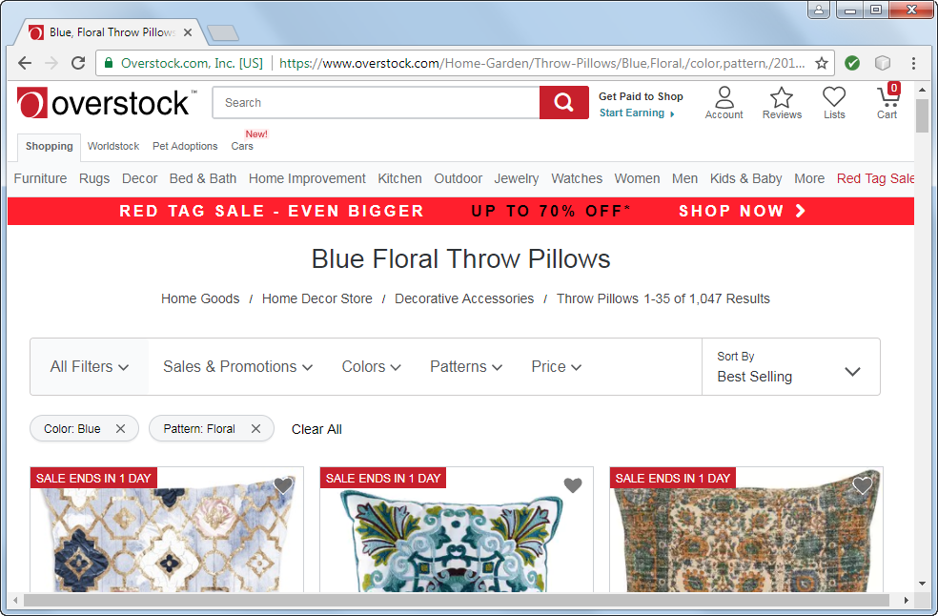
A website that is easy to use (Overstock.com)

Slide 35
What website users want is usability
To find what they’re looking for as quickly and easily as possible
To get information or do a task as quickly and easily as possible

Slide 36
How website users use a web page
They scan the page to find what they’re looking for or a link to what they’re looking for. They do not like to scroll. If they get frustrated, they leave.
They often click on links and buttons with the hope of finding what they’re looking for. They frequently click on the Back button when they don’t find it.

Slide 37
Four guidelines for improving usability
Present as much critical information as possible “above the fold”.
Group related items and limit the number of groups on each page.
Include a header that identifies the site and provides a navigation bar and links to utilities.
Use current navigation conventions, like including a logo that goes to your home page when clicked and a cart icon that goes to your shopping cart when clicked.

Slide 38
Guidelines for cross-browser compatibility
Test your web pages on all of the major browsers, including older versions of Internet Explorer that are still in common use.
Use the features of HTML5 and CSS3 that are supported by all modern browsers. But use the workarounds so those features will work in older browsers too.

Slide 39
Accessibility laws that you should be aware of
The Americans with Disabilities Act (ADA).
Sections 504 and 508 of the Federal Rehabilitation Act.
Section 255 of the Telecommunications Act of 1996.

Slide 40
Types of disabilities
Visual
Hearing
Motor
Cognitive

Slide 41
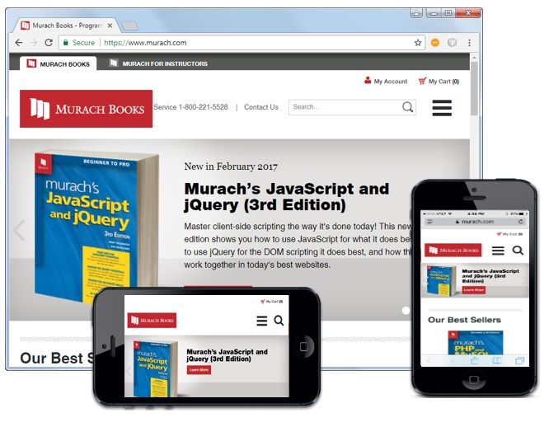
The Murach Books website on different devices

Slide 42
What is Responsive Web Design?
Responsive Web Design refers to websites that are designed to adapt gracefully to the screen size.
Typically, the overall look-and-feel of a website will remain consistent from one screen size to the next.
Media queries, scalable images, and flexible layouts are the backbone of Responsive Web Design.

Slide 43
Objectives
Applied
Load a web page from the Internet or an intranet into a web browser.
View the source code for a web page in a web browser.
Knowledge
Describe the components of a web application.
Distinguish between the Internet and an intranet.
Describe HTTP requests and responses.
Distinguish between the way a web server processes static web pages and dynamic web pages.
Name the five major web browsers.
Describe the use of JavaScript.
Distinguish between HTML and CSS.

Slide 44
Objectives (cont.)
Explain how you deploy a website on the Internet.
Describe the components of an HTTP URL.
Describe these five web development issues: Usability, Cross-browser Compatibility, User Accessibility, Search Engine Optimization, and Responsive Web Design.

